Slide 1


Flight Prices Analysis
California State University, Los Angeles
CIS 5200 – System Design and Analysis
Dr. Jongwook Woo
Team Members: Ragi Dave, An Mach,
Ankita Hasmukhbhai Savaliya, Bhumika Suvagia

Slide 2

AGENDA
Goals
Dataset Information
Hardware Specification
Architectural Workflow
Analysis
Conclusion

Slide 3

goals
Provide a high-level, general and aggregated approach to hive analysis.
Performed analysis could be valuable for travelers who are looking to plan their trips in advance and find the best deals on flights. Such as,
What are the top 10 most popular routes?
Which airport has the highest traffic during August and September?

Slide 4

Flight Data Introduction
This dataset contains flight prices and includes information on flight itineraries from April to November 2022. The size of the dataset is 31.09 GB. In the dataset, there are 27 columns, we utilized only 17 of them.
Flight information to and from 16 airports, including ATL, DFW, DEN, ORD, LAX, CLT, MIA, JFK, EWR, SFO, DTW, BOS, PHL, LGA, IAD, and OAK.
Notes:
The Flight Prices Dataset is a CSV file which contains information about purchasable airline tickets for travel between April 16th, 2022, and October 5th, 2022.
The dataset includes flight information to and from 16 airports, including ATL, DFW, DEN, ORD, LAX, CLT, MIA, JFK, EWR, SFO, DTW, BOS, PHL, LGA, IAD, and OAK.
By doing a tempo-spatial analysis, it is possible to determine the months in which destination airports experienced high traffic volume.

Slide 5
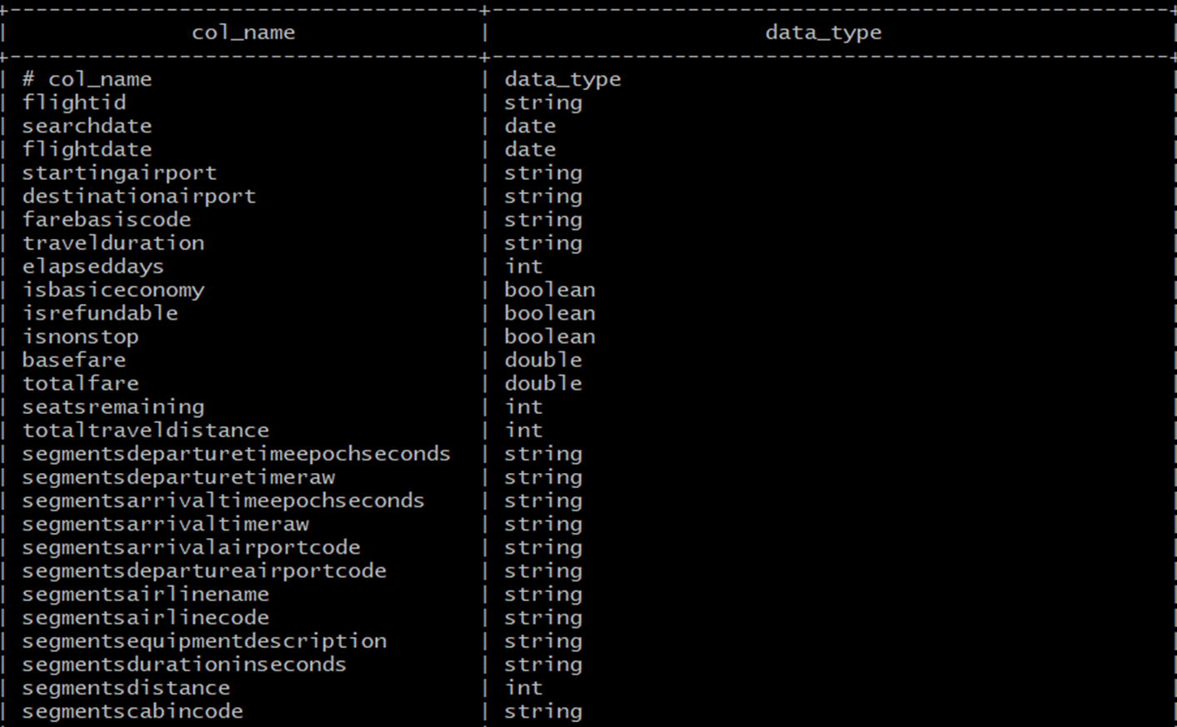
FlightData table
Notes:
This is the Hive table we created based on the original itineraries.csv files and its datatypes. It has 27 columns and comprises of itinerary related data such as flight date, airfare, starting airports, destination airports, and so on.

Slide 6
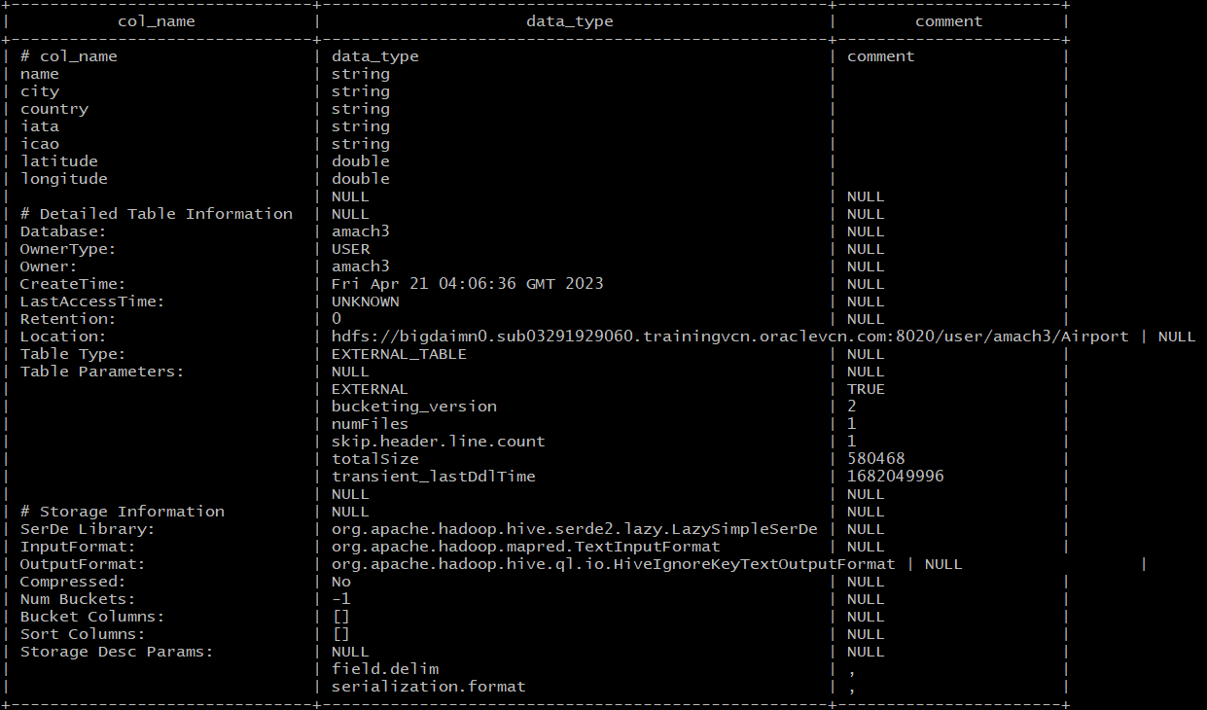
Airport table
Notes:
This is another table that we created in hive based on airports.csv file, It has 7 columns and its datatypes.
Since the Flight Prices dataset only contains airport codes without other geographical data, an additional Airport Codes data set that contains airports’ latitude and longitude is needed to conduct tempo spatial analysis.

Slide 7

Dataset Information
DATASET NAME: Flight Prices
DATASET URL:​
https://www.kaggle.com/datasets/dilwong/flightprices
https://www.kaggle.com/datasets/mike90/airport-codes
TOTAL SIZE:​​ 31.09 GB
COUNTRIES CONSIDERED: USA
NUMBER OF FILES: 2
FILE FORMAT:​ CSV
GITHUB LINK: https://github.com/amach3/Flight-Price-Analysis.git

Slide 8

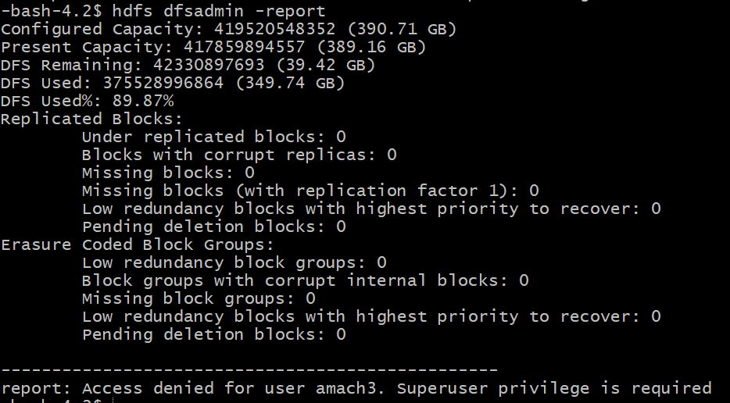
Hadoop Cluster Specification
Cluster Version: Hadoop 3.1.2
CPU Speed: 1995.312 MHz
Number of CPU cores:
8 cores x 5 nodes = 40 cores
Number of nodes: 5
(2 Master and 3 Worker)
Total Memory Size: 390.71 GB

Slide 9






Architecture Workflow
Data Source
Upload data into HDFS
Download
Dataset
Data Warehousing
Data Engineering
Reduce data size to only 10%
Drop 10 unusable columns
Remove duplicate records
Remove null values
Add columns by extracting the data we need
Query Data
Roles:
An: Download & upload data into HDFS, create tables in Hive
All: Perform data cleaning, write queries, create visualizations together during Teams meetings
Bhumika, Ankita, Ragi: write analysis on visualizations
Create Visualizations
Notes:
Raw files were uploaded and stored in HDFS and then loaded into tables using Beeline Client. We created two tables, FlightData and Airport, each point to the respective directory in HDFS. Data cleaning was conducted using different techniques such as random sampling, concatenation, null removals, and so on.
The FlightData table has 82,138,753 records. Since the big data size could negatively affect other classmates and labs, we were instructed to reduce our data to 10% of the original size by randomly sampling it. Below is the sampling code:
select * from FlightData
where rand() <= 0.1
distribute by rand()
sort by rand()
limit 8000000;
The original FlightData table has 27 columns, but we were not going to use all of them for our analysis and visualizations, so we dropped the unusable columns with the RELACE COLUMNS action using HiveQL. The resulting table has 17 columns. We further removed any duplicate records. Since our dataset is huge (almost 8 million rows of data), we chose to remove any row that contain null values.
We added two additional columns that we needed for our analysis. The first one is FlightMonth column which was populated with the month from FlightDate column. The second is FlightRoute column that concatenate startingAirport with destinationAirport columns.

Slide 10
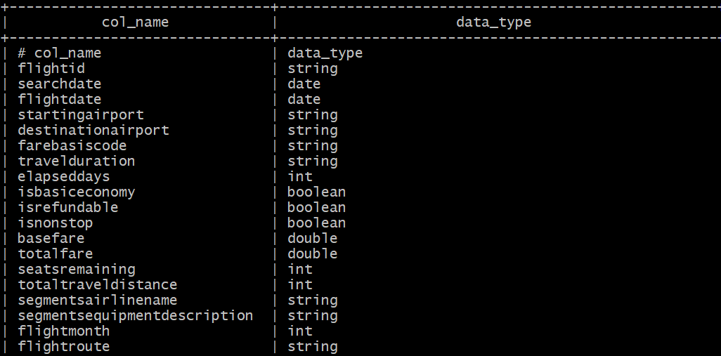
FlightData2 table (After Data Cleaning)
Notes:
Before cleaning: 82 million rows
After cleaning: 74 million rows

Slide 11

Analysis

Slide 12
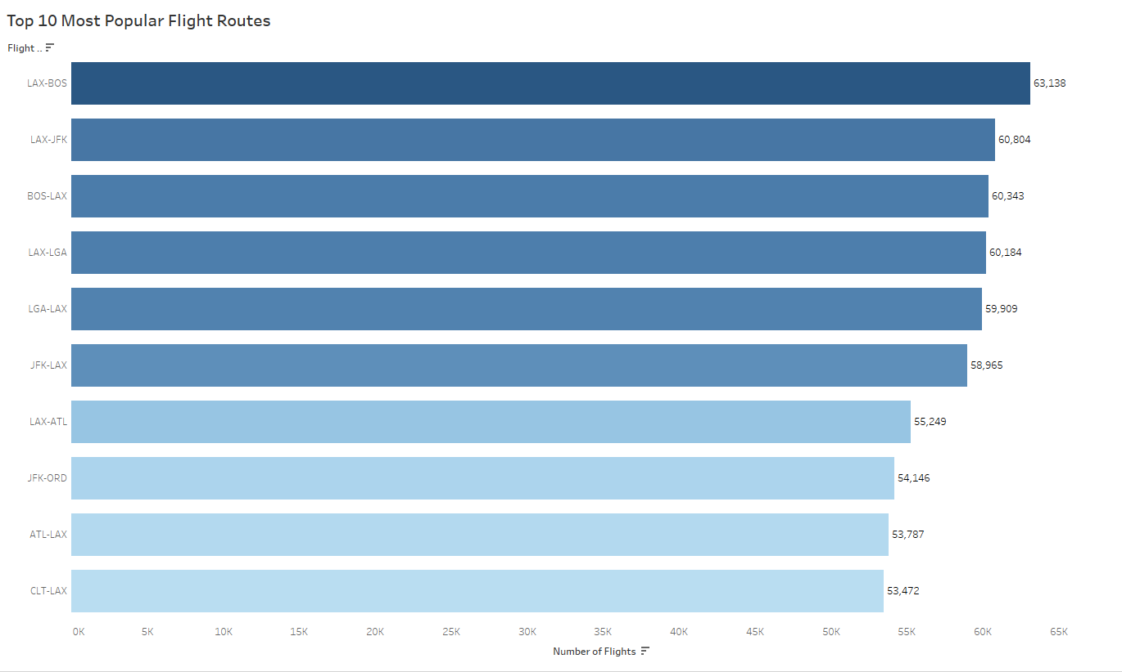
Notes:
The horizontal bar graph depicts the top 10 most popular flight routes in the United States between April and November 2022 where the X and Y axis represent the number of flights and flight routes respectively.
Most of the routes involving either LAX or one of the East Coast airports – BOS (Boston), JFK (Queens, NY), LGA (LaGuardia, NY), or CLT (Charlotte).
Specifically, the route between LAX and BOS is the most popular, with over 63,000 flights recorded.
After creating this chart, it can be observed that Los Angeles (LAX) was a popular destination or connection point for the travelers as it is involved in nine out of the top ten flight routes, except for the JFK-ORD route. According to the article “Busiest Airline Routes in the U.S.”, New York to Los Angeles and New York’s LaGuardia to Chicago are in the third and fourth place.[2] Comparing that to Figure 1, the JKF-LAX route is at the sixth place with 58,965 flights on Expedia; the JKF-ORD route is at the eighth place with 54,146 flights.
West coast airport – LAX, ATL
East coast airport – BOS, JFK, LGA, CLT.

Slide 13
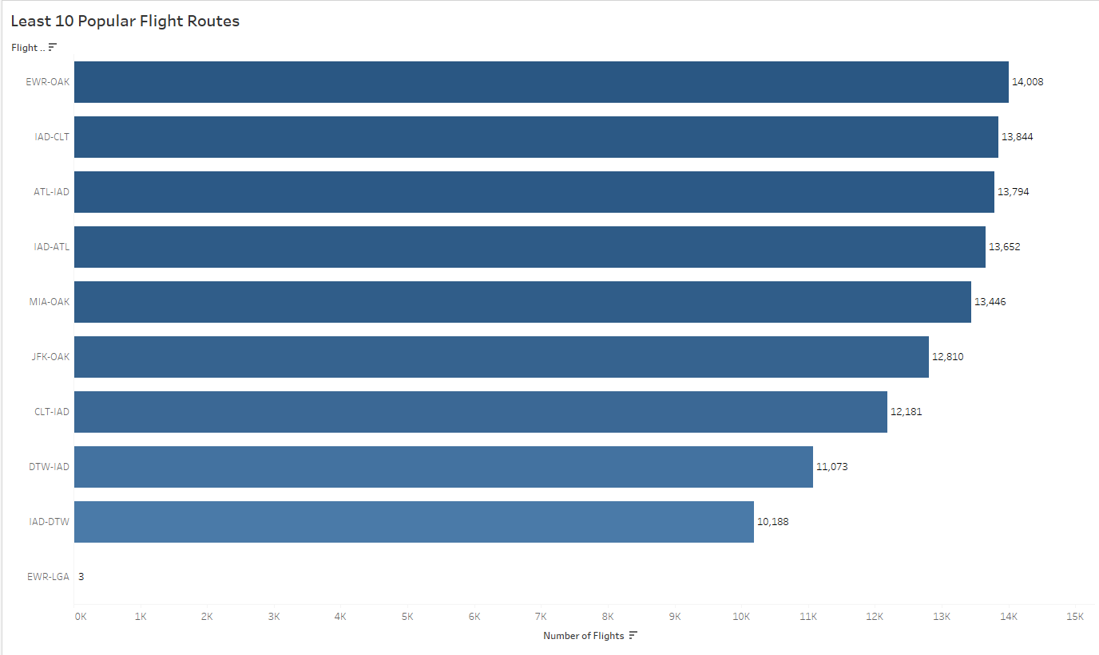
Notes:
It indicates the routes with the lowest demand by showing the airport names and the number of flights for each route.
The route between EWR and LGA had the lowest number of flights, which accounted for only 3 flights of the cleaned dataset. This is most likely due to the short distance between the two airports.
According to Air Miles Calculator website, “The driving distance from Newark (EWR) to New York (LGA) is 23 miles / 37 kilometers, and travel time by car is about 41 minutes… The estimated flight time from New York Newark Liberty International Airport to New York LaGuardia Airport is 31 minutes”.[2] It is more convenient to drive between EWR and LGA airports unless they are part of a connected flight.
The EWR to OAK route topped the chart with only 14,008 flights. By visualizing the details, we also noticed that IAD(washington dulles airport) was the least popular airport as it appeared in six of them in this graph.

Slide 14
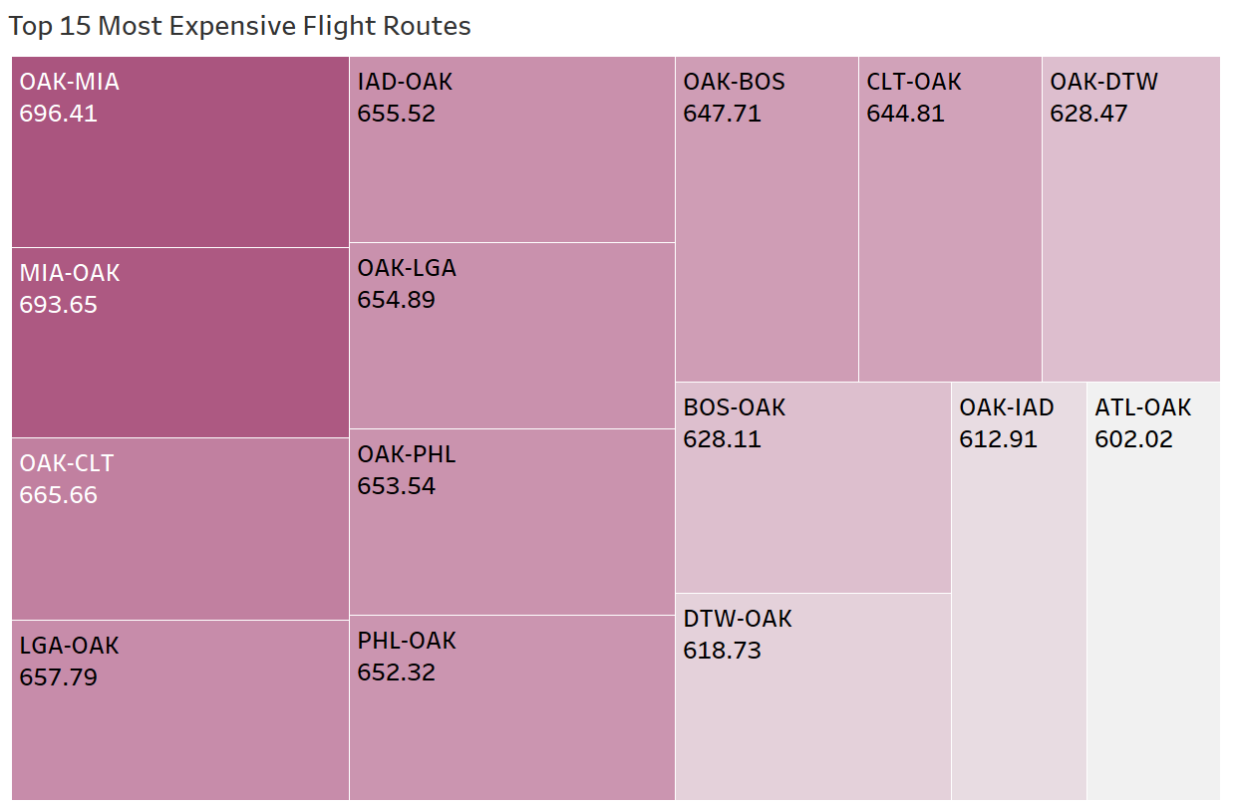
Notes:
-For our analysis, we have chosen to focus on the top 15 flight routes that are the most expensive. The heat map shows that the route from Oakland (OAK) to Miami (MIA) ranks the top of the chart with the average airfare of $695. Interestingly, all of the top fifteenth most expensive flight routes involve OAK as either the departing or arriving airport. On average, any flight related to OAK has a cost greater than $600, while the least expensive route from is from Atlanta (ATL) to Oakland (OAK) at $602.

Slide 15
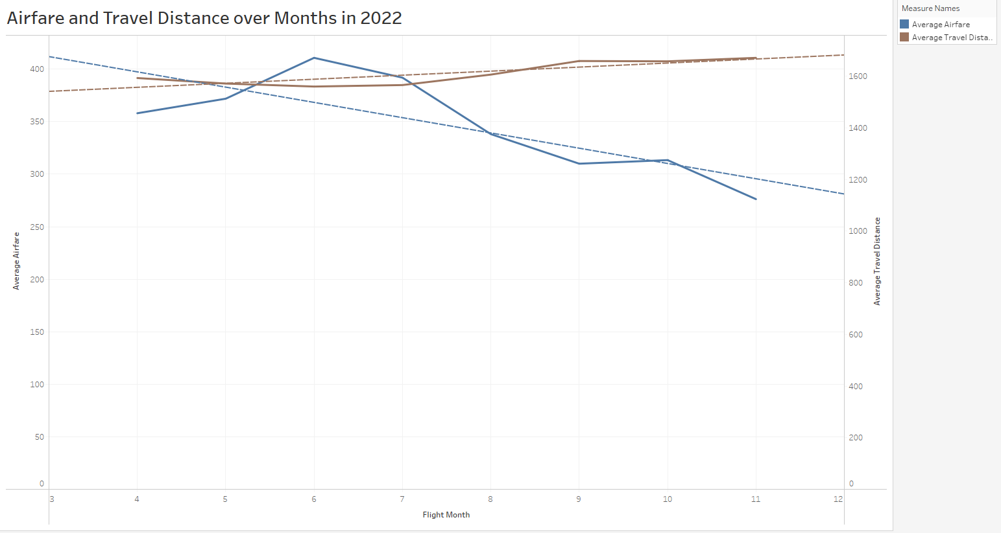
Notes:
The analysis found that in June (month 6), airfare was considerably higher (above $400) for travel distances less than 1600 miles.
However, in November(month 11), the airfare was more affordable (ranging between $250 to $300) for travel distances more than 1600 miles.
Additionally, the trend line shows that as airfare (represented by the blue dotted line) decreases, there is an increase in travel distance (represented by the brown dotted line).

Slide 16
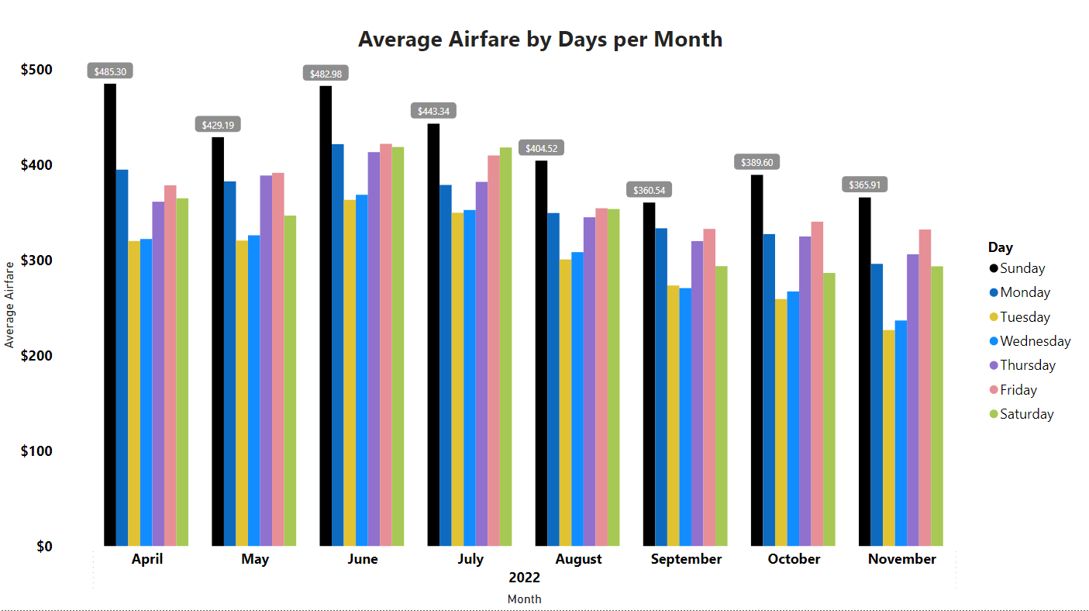

Slide 17
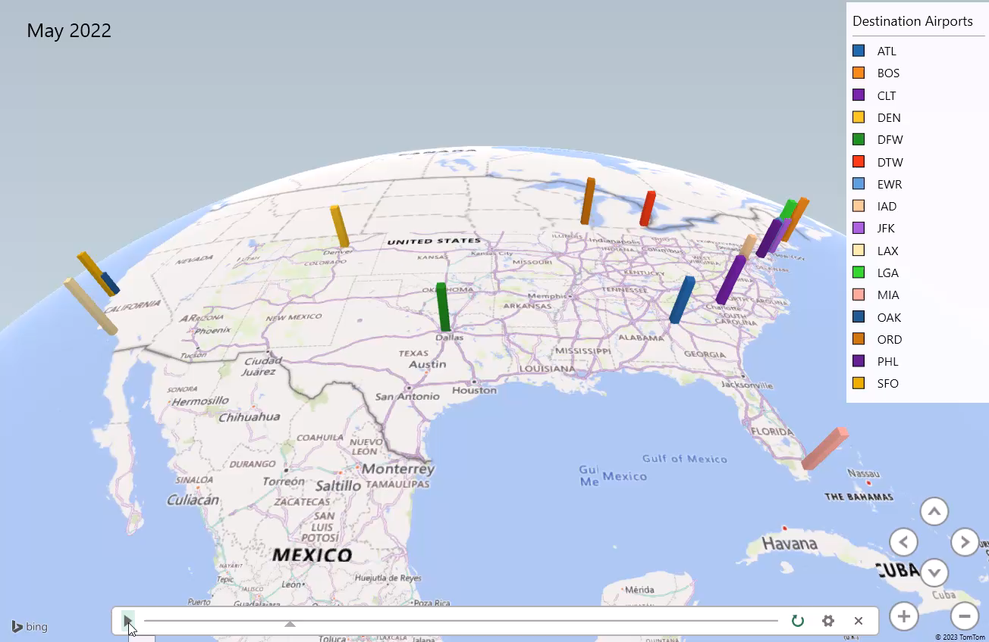
Notes:
In August and September, the majority of destination airports experienced higher traffic.
It was observed that in April and November, the majority of destination airports experienced lower traffic.

Slide 18
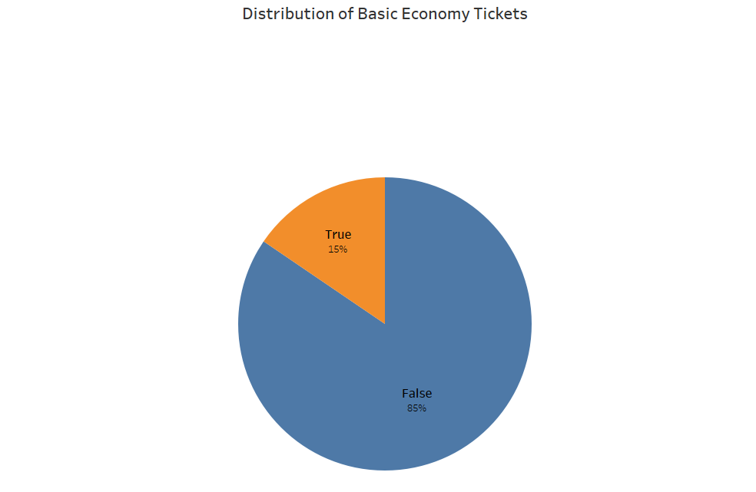
Notes:
The pie-chart indicates that the airline industry offers only 15% of basic economy tickets.

Slide 19
CONCLUSION
Data Analysis Summary:
The report highlights the top and least 10 flight routes based on the number of tickets sold.
The report also identifies the top 15 most expensive flight routes, based on the ticket price.
In June, airfare was found to be higher in comparison to the traveled distance.
In August and September, the majority of destination airports experienced higher traffic.
It was observed that airlines offer only a small proportion of basic economy tickets.
Further research could be conducted by analyzing data from additional airports to gain a more comprehensive understanding of the trends in the airline industry.

Slide 20

Thank you

